Slide 1

Screen Time Trade-Offs: Age, Money & Modern Life
Yuliia Chernysheva
Paul Hansford
Data Visual With Tableau
30 July 2025
Source: https://data.world/sonalnew/average-time-spent-by-a-user-on-social-media/workspace/file?filename=Average_time_spent_by_user.csv

Slide 2

Dataset: Average Time Spent by Users on Social Media
Source: data.world
Description: This dataset reveals the average daily time users spend on social media across devices.

Slide 3

Screen time isn’t just about age — income, debt, and lifestyle choices reveal who’s online the longest and why.

Slide 4
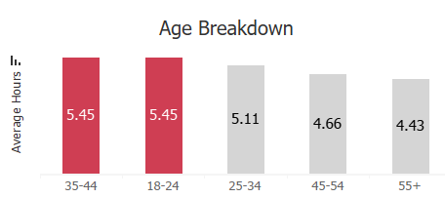
Red = Over 5.2 hrs daily | Gray = Under 5.2 hrs daily
👉 First, the obvious: Younger people do spend more time online — but the details matter.

Slide 5
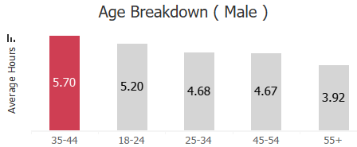
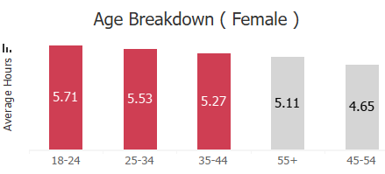
👉 Women aged 18–44 spend the most time online, while men peak at ages 35–44.

Slide 6
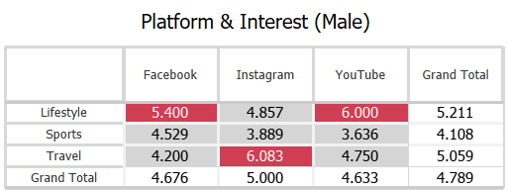
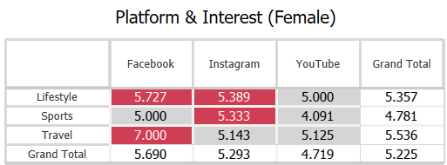
Interests play a big role too:
👉 Women like Travel on Facebook; men focus on Travel and Lifestyle on Insta and YouTube.

Slide 7
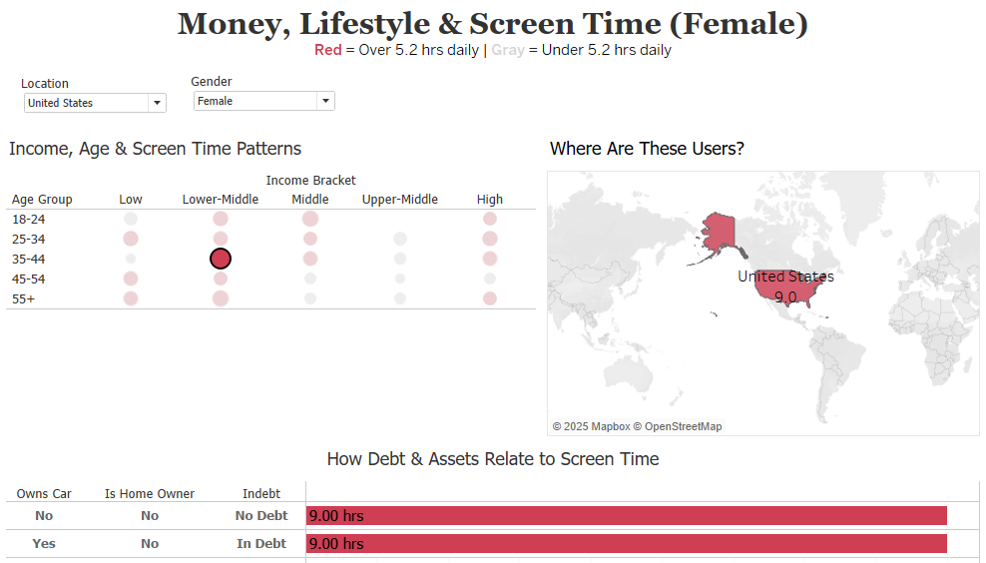
👉 Women 35–44, lower-middle income, renters without family — more solo screen time.
Notes:
But time online isn’t only about age. Money and lifestyle factors also matter.

Slide 8
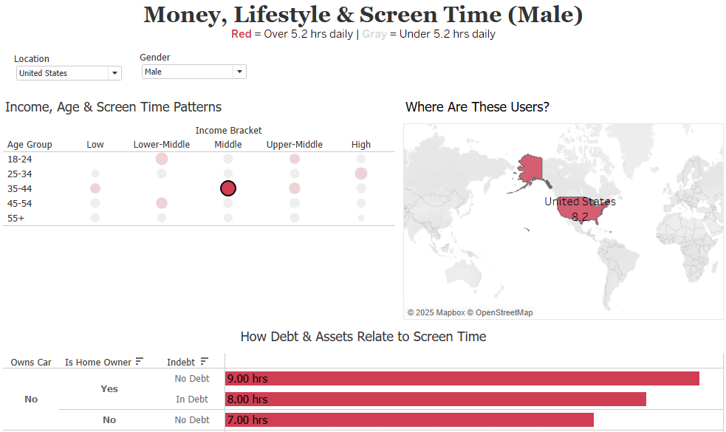
👉 Men 35–44, middle income — often no car, more time online instead.

Slide 9

These patterns show how lifestyle choices and family situations shape screen time — more stability and offline responsibilities often mean less time online.

Slide 10

Skills I Gained
Learned Tableau Desktop and Tableau Prep tools.
Created simple visuals: bar charts, scatter plots.
Improved using colors, fonts, and adding annotations.
Explored interactivity — my favorite part!

Slide 11

At first, I tried to read everything and memorize it all.
Later, I found it’s better to dive in, practice, and tackle problems as they come — that worked much better.
Next time: more doing, less overthinking!

Slide 12

Couldn’t install Tableau Prep, so I had to borrow my son’s computer from time to time.
Many broken links cut into my practice time.
Didn’t open the second book — I’ll catch up during the break!

Slide 13

Big thanks to the teacher for real teaching and second-chance homework.
Grateful to classmates — everyone was amazing!

